Slide 1

Cyber Girls 4 . 0 Open Day Project
Automated Phishing Attack Simulation
Group Number 6
Names: 1. Tetuh Wibinah CG/24/0413 - Cameroon
2. Audrey Isutsa CG/24/0665 - Kenya
3. Florence Kabona CG/24/0235 - Kenya
4. Praise A. Utibe CG/24/0709 Nigeria
5. Ivy Owusu CG/24/0726 Ghana

Slide 2

Introduction
The digital landscape faces increasing threats from sophisticated cyberattacks, particularly phishing attacks.
This presentation explores developing automated tools using Bash script to simulate phishing attacks in a controlled environment.
By understanding attacker methodologies and identifying vulnerabilities, We can strengthen our defenses against these threats.

Slide 3
Objectives
The objectives of this project is to:
Develop a bash script to simulate phishing attacks
2. Observe and document results for further analysis

Slide 4
Phishing
Phishing is a type of social engineering attack often used to steal user data, including login credentials and credit card numbers.
It occurs when an attacker, masquerading as a trusted entity, dupes a victim into opening an email, instant message, or text message.
There are several types of phishing which are whaling, vishing, spear phishing and email phishing.

Slide 5
Phishing Attack Simulation
Zphisher, a phishing tool was utilized to implement this part of the project due to its capability to generate phishing pages and manage various aspects of the attack.
Additionally, Bash scripts were created to automate the phishing process.

Slide 6
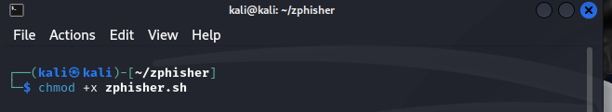
Running Zphisher
Installation of Zphisher
Installing zphisher and navigate to its directory
git clone https://github.com/htr-tech/zphisher
cd zphisher
Giving execute permission to zphisher
Run the bash, bash zphisher.sh if already installed.
Bash Script for Phishing Attack
Running Zphisher
Installation of Zphisher
a. Installing zphisher and navigate to its directory
git clone https://github.com/htr-tech/zphisher
cd zphisher
b. Giving execute permission to zphisher

Slide 7
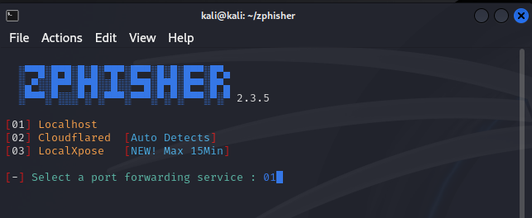
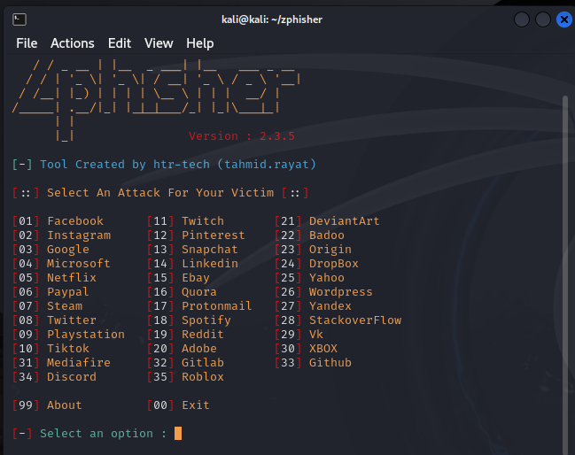
Bash Script for Phishing Attack
c. Run the bash, bash zphisher.sh if already installed. Select 03 for Google which is the webpage that we will clone.
d. To create a port forwarding service, select 01 Localhost

Slide 8
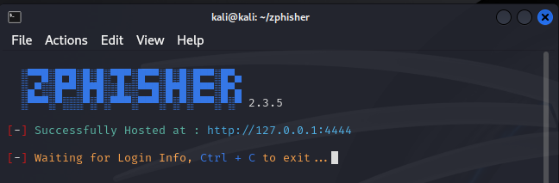
.
e. After creating a custom port 4444, here is the phishing link to attach on the email body.
http://127.0.0.1:4444

Slide 9

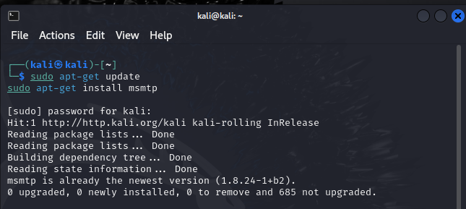

Sending Email Using Bash
Install msmtp to send mail with authentication.
2. Configuring the msmtp.

Slide 10
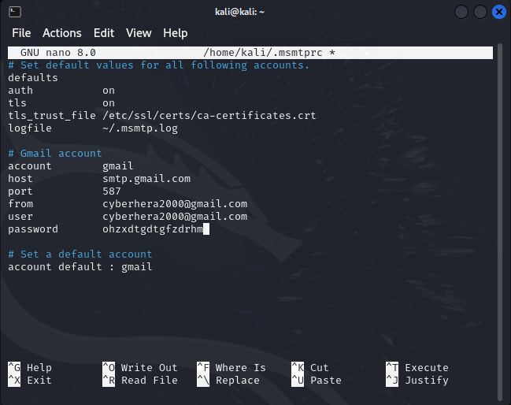
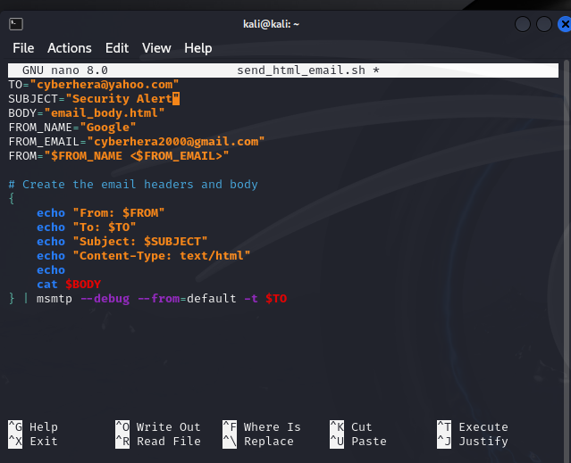

4. Making the script executable
3. Bash script to send email

Slide 11
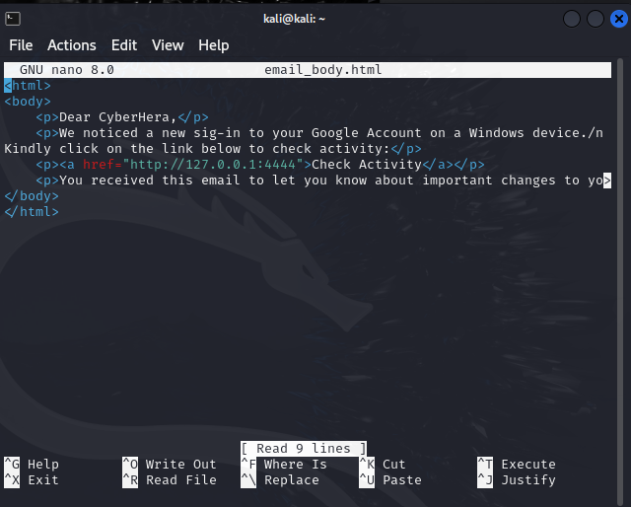
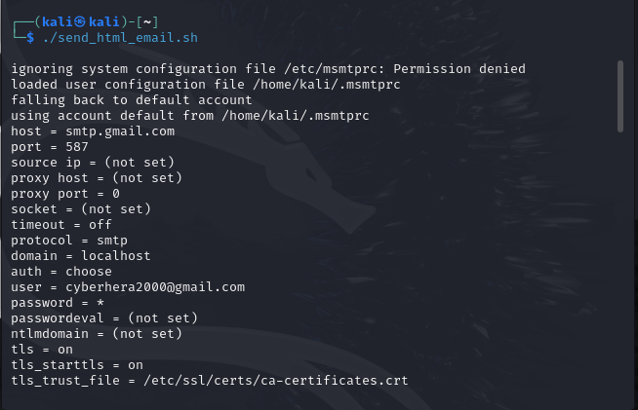
5. Creating the email body using a nano file.
6. Run the script to send the mail ./send_html_email.sh

Slide 12
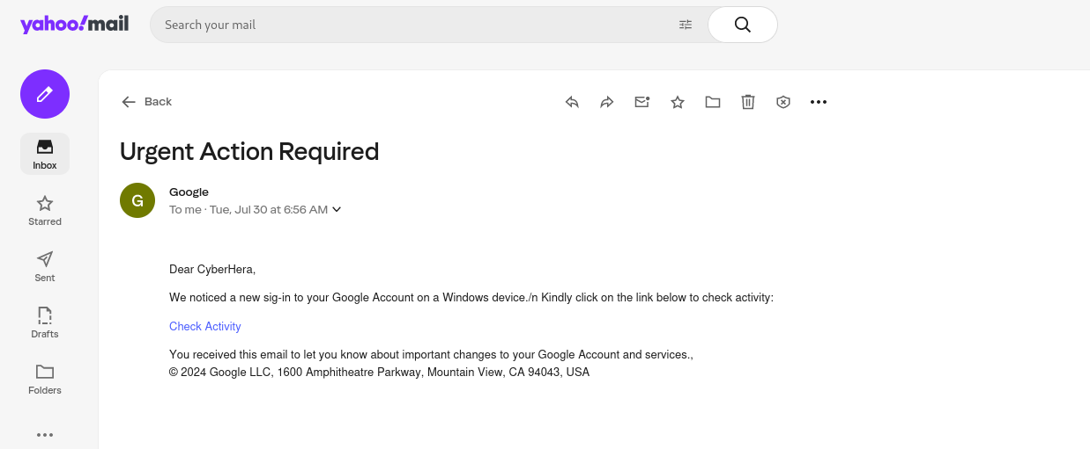
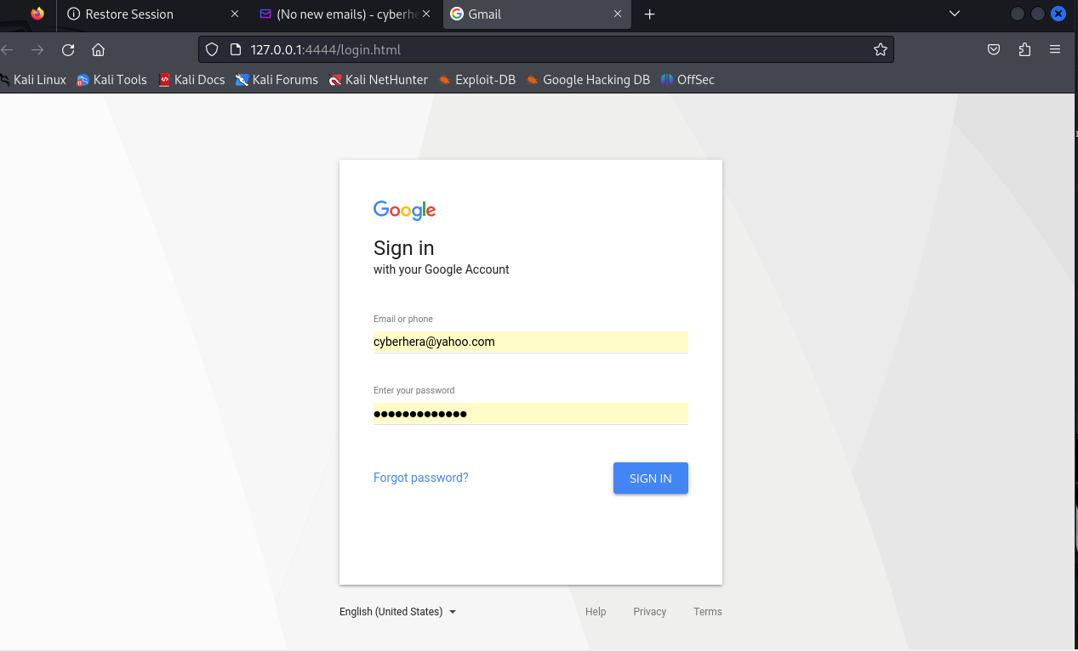
Proof that the target received the email. Once user clicks on the link, they will be re-directed to the cloned Google page where the user will log into their account.

Slide 13
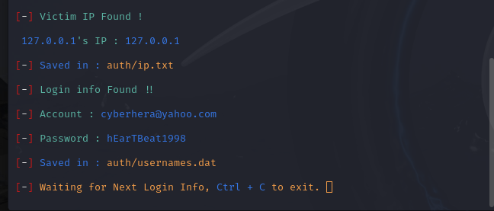
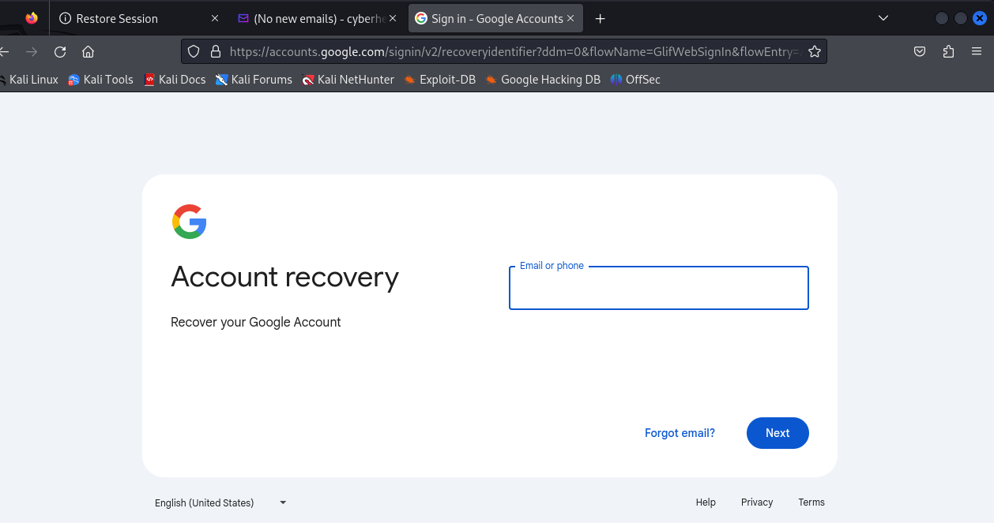
9. Proof that our target clicked on the sent link. Here we collected the login data using ZPhisher.
10. After the user types in login information, they will be re-directed to the genuine google page for account recovery

Slide 14
Thank You

